Slide 1
Tracking the Sun
Our process:
Design Goals
Track the sun
Low cost:efficiency ratio
Reliability
Be pretty
Divide and Conquer
Mechanical Design
Electronics Design
Algorithm Design
Verification and Testing

Slide 2
Design Goals
Tracking the sun
Follow the sun as the day progresses.
Low cost:efficiency
Every dollar spent needs to contribute as much or more
Sacrificing good design for low cost is NOT okay
Reliability
Don’t break
Be pretty
At minimum, contain the capability of being aesthetically pleasing
Get people to use it, many people oppose solar power because it’s ugly.
Source and data available at:
github.com/AnthonyLam/solaaar

Slide 3
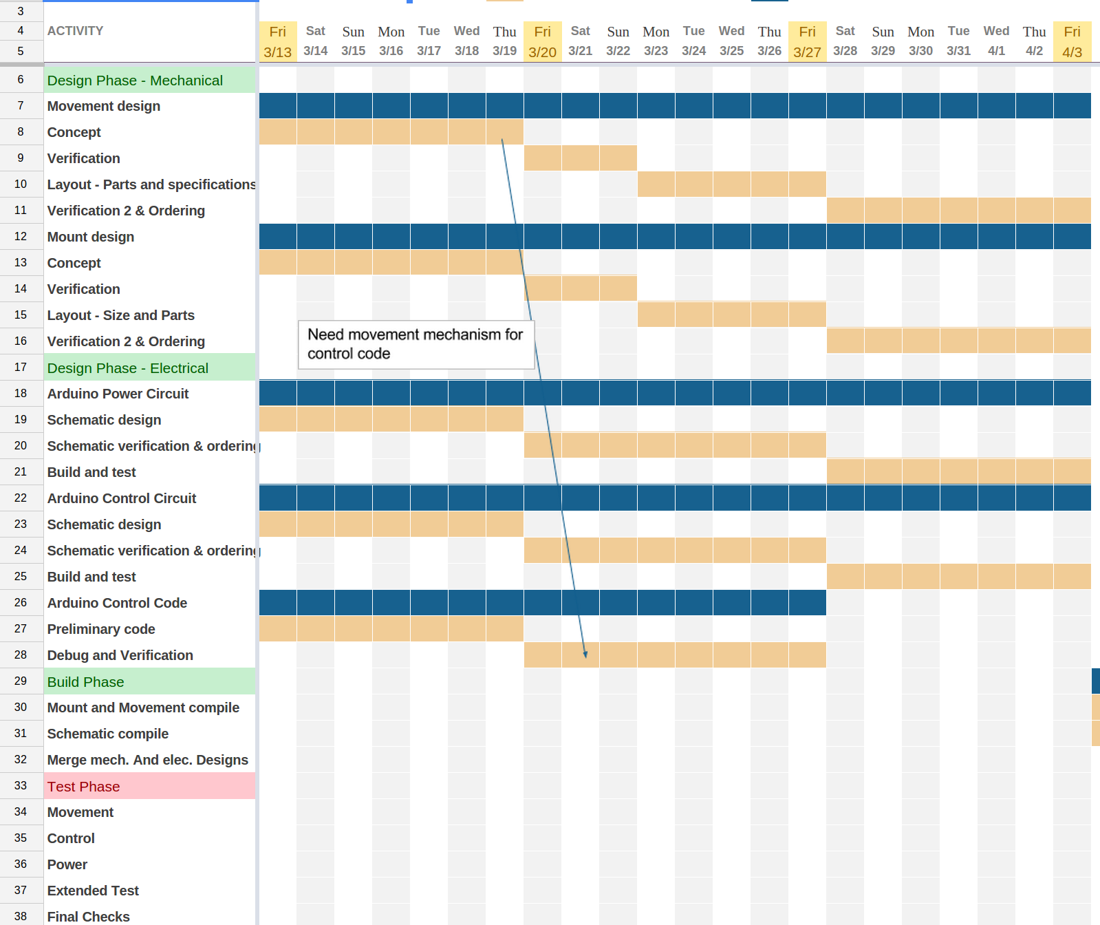

Slide 4
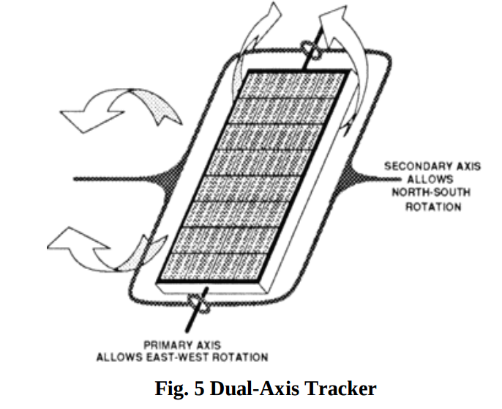
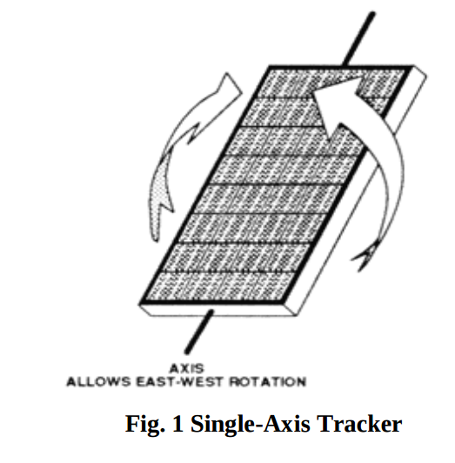
Mechanical Design
Research indicates dual axis tracking is typically worth the trade off in cost versus single axis tracking.¹
Opted for a single axis design.
¹Dual axis vs single axis tracking
Given our target customer: ease of use and maintenance is a priority over absolute efficiency.

Slide 5
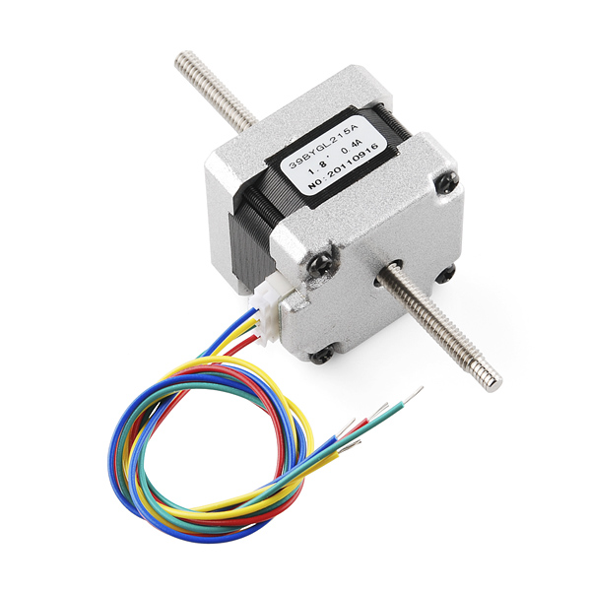
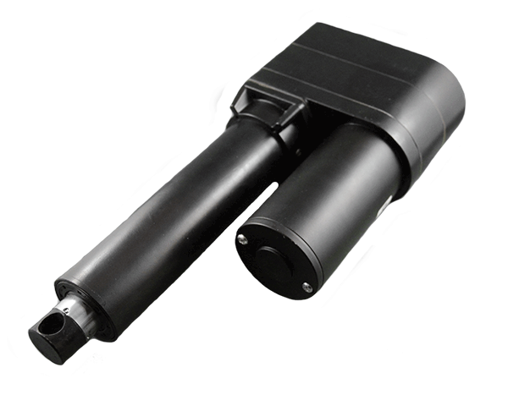
Mechanical Design
Multiple forms of mechanical motion are available: servos, steppers and actuators.
Threaded stepper motors yielded the greatest benefit for our system at a lower price point and a smaller form factor with a higher torque rating.
Threaded Stepper
Linear Actuator

Slide 6
Mechanical Design
Gathered data on various materials that yield the greatest results for the lowest amount of money.

Slide 7
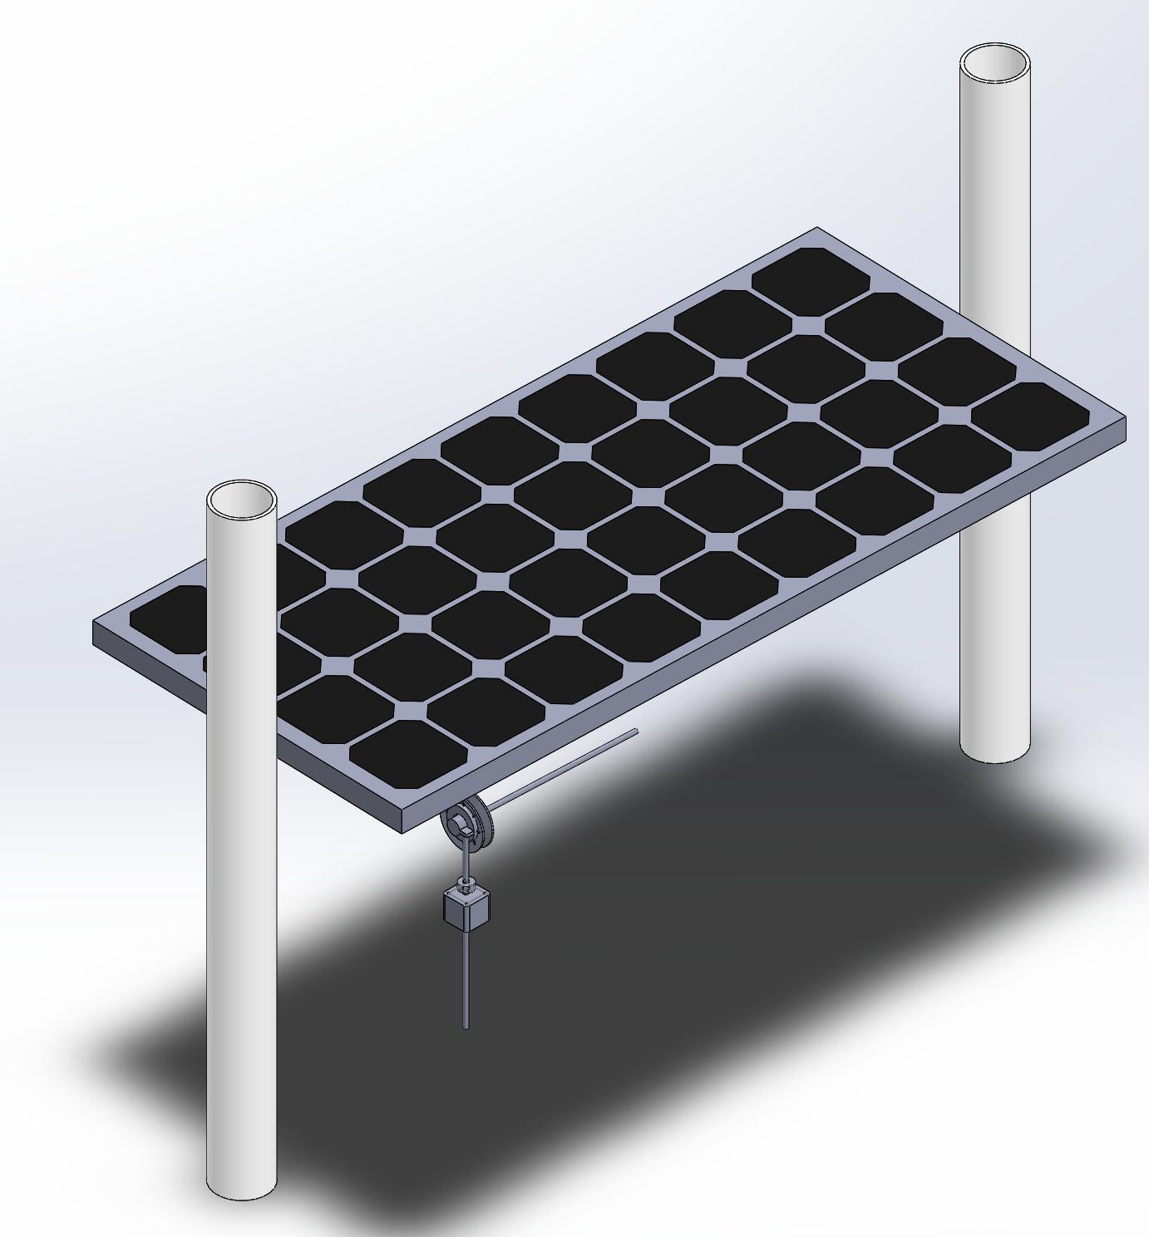
Mechanical Design
Preliminary design

Slide 8
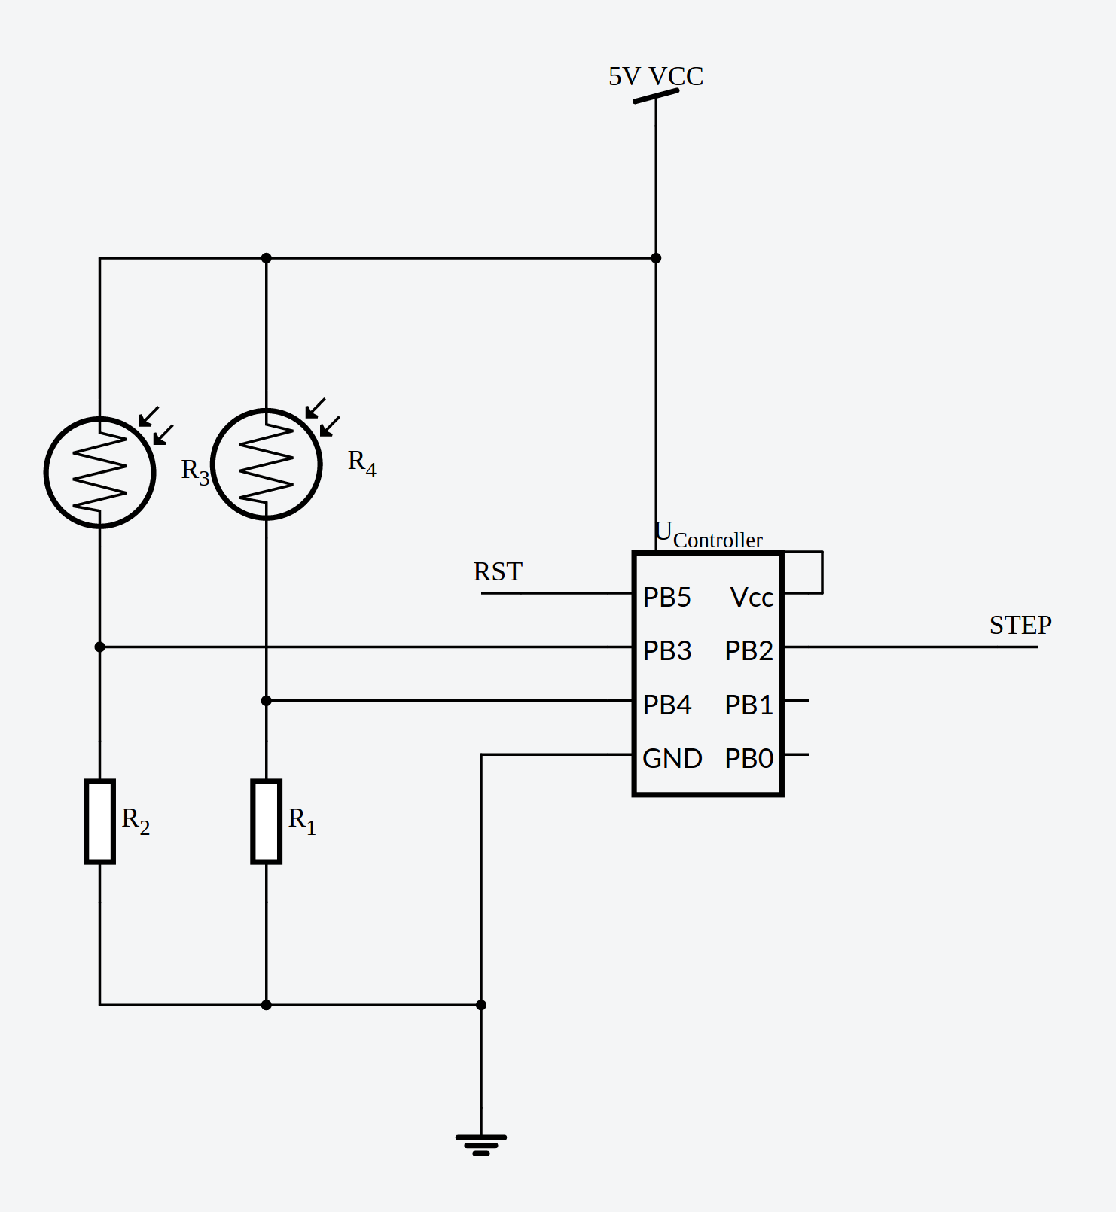
Electronics Design
Simple logic and design means we could potentially do without a complex microcontroller.
TTL would take too long to implement and a full Arduino is too much. An ATTiny85 will serve our purposes.
Can be dropped to 1 Mhz clock. Yay power savings
Small form factor
Extremely cheap (50c)

Slide 9
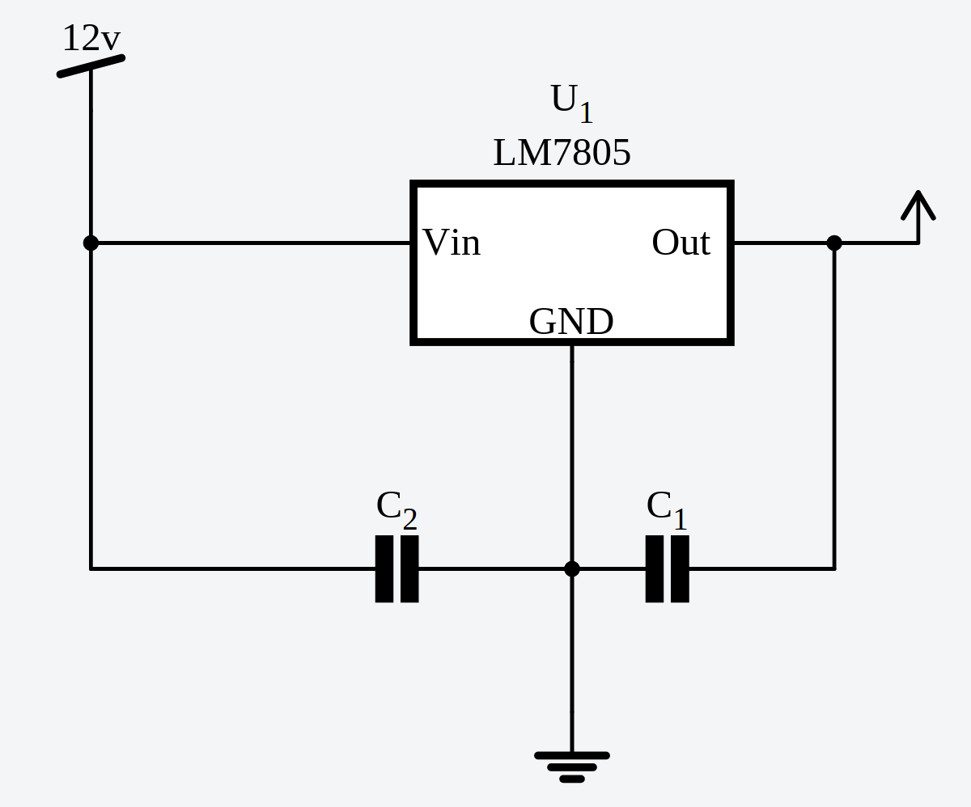
Electronics Design
Design for voltage regulation comes down to 2 different designs:
Space constraints are a concern and the power loss is minimal since we deal with low currents.
Other circuit wouldn’t fit. Just imagine a voltage regulator with lots of resisters, an inductor and a capacitor.

Slide 10
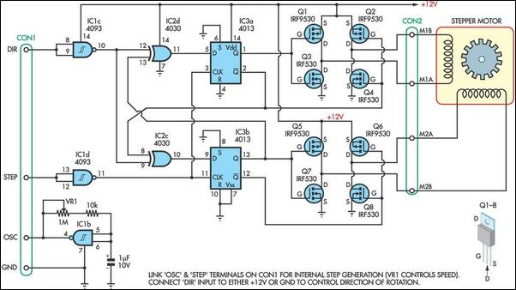
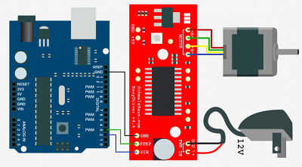
Electronics Design
Motor Control: custom build or use a proven solution?
Use of the ATTiny85 reduces the available pins.
Error prone circuit design or a nicely packaged PCB? It has Ez in the name.
EasyDriver
FET circuit for stepper control
EasyDriver

Slide 11
Algorithm Design
Our program can’t be debugged easily when put into the system so it must have fault tolerant behavior and must account for every predictable scenario.
Derive an event driven system from a finite state machine.
Minimize impact on runtime: We have very little memory, storage and clock cycles
Use little power: tune built in clock down to 1 Mhz from 8Mhz

Slide 12
Algorithm Design
Our algorithm states are defined by a 4-bit value representing various inputs.
LDRw > LDRe = 1
LDRw < LDRe = 0
LDRe+LDRw > threshold = 1
LDRe+LDRw < threshold = 0
Panel @ extreme = 1
Panel inbetween = 0
Sense light = 1
No light = 0
S1
S2
S3
S4

Slide 13
Algorithm Design
Action | S1 S2 S3 S4 | M
SLEEP | 0000 | 10
PAN | 0001 | 11
SLEEP | 0010 | 10
PAN | 0011 | 11
SLEEP | 0100 | 10
R EAST | 0101 | 00
SLEEP | 0110 | 10
PAN | 0111 | 11
SLEEP | 1000 | 10
Only half of the table is shown but idea should be clear. Each action is represented by a 2-bit binary value and determined by the States: S1 S2 S3 S4.

Slide 14
Algorithm Design
The previous table was too clunky and would result in inefficiencies. Here we apply a Karnaugh Map to simplify our algorithm down to 2 equations.
 | 00 | 01 | 11 | 10
00 | 1 | 1 | 1 | 1
01 | 1 | 0 | 0 | 1
11 | 1 | 1 | 1 | 1
10 | 1 | 1 | 1 | 1
 | 00 | 01 | 11 | 10
00 | 0 | 0 | 0 | 0
01 | 1 | 0 | 1 | 1
11 | 1 | 1 | 1 | 1
10 | 0 | 0 | 0 | 0
M1 = S2+!S3+S4
M2=S3S4+S4!S2+S4S1

Slide 15
Total Cost
Ceramic Capacitor x2 | $0.61 | PVC x 20 ft | $10.86
Resistors x2 | $0.20 | Belt | $9.99
ATTiny85 | $1.70 | Stepper Motor | $32.00
Photoresistors x3 | $2.70 | Pulley | $4.58
LM7805 | $0.67 | Misc. Parts est. | $20.00
 |  | Est Cost : | $83.31
Notes:
Via digikey, robotdigg, amazon w/ prime!, homedepot

